Slide 1
ICS 141 – Programming With Objects
Lecture 10 – Robert Jahn
Based on the slides of Dr. Daniel Liang

Slide 2
Object Composition
Composition is actually a special case of the aggregation relationship. Aggregation models has-a relationships and represents an ownership relationship between two objects. The owner object is called an aggregating object and its class an aggregating class. The subject object is called an aggregated object and its class an aggregated class.

Slide 3
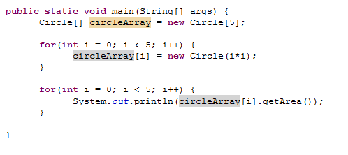
Array of Objects, cont.
Summarizing the areas of the circles

Slide 4
Abstract Classes
We’ve been working with larger and more complex solutions. To this point, any class we have created has been a concrete/normal class. Up next, we are going to discover a new type of class: The abstract class.
Let’s consider the example we discussed a few weeks ago.
Let us write out a solution that represents Students, Grad Students, Instructors, and Professors.

Slide 5
Abstract Classes
So, that is the basic idea behind an abstract class.
A class that is so abstract that we have no need in actually creating an object based on it. In fact, java will not allow us to do this. It will give a compiler error if we try.
This begs the question. If we cannot make an object of an abstract class, what is the point of making an abstract class?

Slide 6
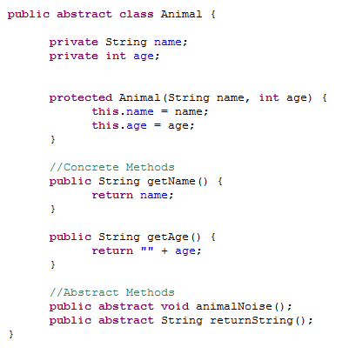
Let’s Jump into an Example

Slide 7
Abstract Classes - Distinctions
As mentioned, an abstract class is one that we cannot use to create objects.
We are unable to use the new operator to create an object as we have usually done.
Conversely, a concrete class is a class that we can use to create objects.
Every class we’ve created to this point has therefore been a concrete class.
Thinking of inheritance for a moment ~
We know that classes become more concrete as we move down the inheritance chain.
That is, the Object class, at the top, is the most general.
The Dog class, on the other hand, is fairly specific.
The idea behind an abstract class ~
A class so general that it really serves no purpose as an actual object.
We’ll simply use the abstract class to extend other classes.

Slide 8
Abstract Classes
Essentially, what we have is that abstract classes will serve as a blueprint for future classes to be created.
We’ll define some data fields, constants and methods to be used in future classes.
We’ll still inherit all visible members as we do with normal inheritance.
Within an abstract class, we can have two types of methods:
Normal methods and abstract methods.
Normal methods we’ve seen before.
Abstract methods are new.

Slide 9
Abstract Methods
We declare an abstract method for later use in the subclass.
We only declare the method, using the abstract keyword ~
modifier abstract returnType methodName();
public abstract void print();
Note the terminating semicolon.
We do not define the method, we simply declare it for later use.

Slide 10
Abstract Methods
If we declare a method to be abstract within a class, this forces us to also define the class as abstract.
Therefore, we cannot include an abstract method in a class that is not labeled as abstract.
This brings up an interesting point.
Say we have a concrete subclass that extends an abstract superclass. Say this abstract superclass has a pair of public, abstract methods declared.
We know that the subclass inherits these two methods if they are visible.
Therefore, we inherit the declarations and must implement them in the concrete subclass.
If we do not, the subclass must also be defined as abstract, meaning it is not entirely useful to us.
We must take care when defining our abstract classes as any concrete subclass we create must be able to properly implement its abstract methods.

Slide 11
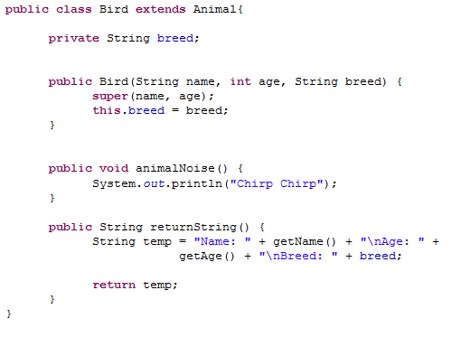
Bird Class - Concrete

Slide 12
Abstract Classes – Some Notes
We’ve been discussing the case where we have an abstract superclass and a concrete subclass.
What about the reverse?
Can we have a concrete superclass and an abstract subclass which extends it?
Yes!
Think of the Object class. This is a concrete class. We can create instances of the Object class. We can then define an abstract class. If we do not specify an inheritance relationship, we implicitly extend the Object class.

Slide 13
Abstract Subclass

Slide 14
Abstract Classes
We know we cannot use the new operator to actually create an instance of an abstract class.
However, we can still use it as a data type.
Therefore, the following would be alright ~
Animal[] animals = new Animal[10];
We’d then set these array references to actual concrete objects ~
animals[0] = new Bird(“Petey”, 5, “Finch”);

Slide 15
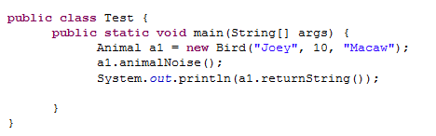
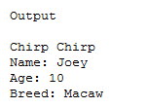
Bird Class - Concrete

Slide 16
Exercise #8a

Slide 17
abstract method in abstract class
An abstract method cannot be contained in a concrete class. If a subclass of an abstract superclass does not implement all the abstract methods, the subclass must be defined abstract. In other words, in a concrete subclass extended from an abstract class, all the abstract methods must be implemented, even if they are not used in the subclass.

Slide 18
object cannot be created from abstract class
An abstract class cannot be instantiated using the new operator, but you can still define its constructors, which are invoked in the constructors of its subclasses. For instance, the constructors of Animal are invoked in the Bird class and perhaps some other subclasses we may define.

Slide 19
abstract class without abstract method
A class that contains abstract methods must be abstract. However, it is possible to define an abstract class that contains no abstract methods. In this case, you still cannot create instances of the class using the new operator. This class is used as a base class for defining a new subclass. An abstract class may also contain concrete methods.

Slide 20
superclass of abstract class may be concrete
A subclass can be abstract even if its superclass is concrete. For example, the Object class is concrete, but its subclasses, such as Animal, may be abstract.

Slide 21
concrete method overridden to be abstract
A subclass can override a method from its superclass to define it abstract. This is rare, but useful when the implementation of the method in the superclass becomes invalid in the subclass. In this case, the subclass must be defined abstract.

Slide 22
abstract class as type
You cannot create an instance from an abstract class using the new operator, but an abstract class can be used as a data type. Therefore, the following statement, which creates an array whose elements are of Animal type, is correct.
Animal[] a1 = new Animal[10];

Slide 23
Multiple Inheritance
We have seen many instances of inheritance in Java. In any inheritance relationship we have observed, there has been an important factor.
A subclass can only ever have a single superclass.
That is, we cannot directly extend more than one class.
On the other hand, we do know that a superclass can have many subclasses.

Slide 24
Multiple Inheritance
To this point, we have been focusing on single inheritance.
That is, any class we create would only ever extend a single class.
In computer science, there is also the notion of multiple inheritance.
As we’ll see, Java does not actually allow us to perform multiple inheritance.
Why is this?
First, let us formally define multiple inheritance.

Slide 25
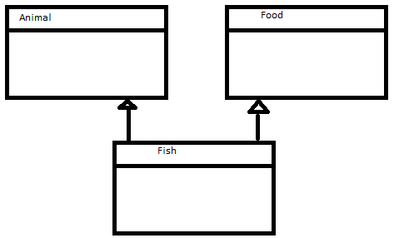
Multiple Inheritance
Multiple inheritance is inheritance in which our subclass inherits directly from two or more classes.
That is, the subclass has two or more superclasses from which it inherits!
As an example, consider a class Fish.
We know a Fish is an animal.
We know a Fish is also food.
We could imagine that the subclass Fish could inherit from both of these classes.

Slide 26
Multiple Inheritance
We can see how this would be useful.
Why does Java not allow us to use multiple inheritance?
It can make a difficult concept even more complex!
Some languages allow multiple inheritance.
C++ and Python
Others don’t, but allow us to mimic multiple inheritance.
Java, Ruby, and C#

Slide 27
Multiple Inheritance
Let us look at a famous example as to why multiple inheritance can be troublesome.
When using multiple inheritance, we can encounter an issue known as the ‘Deadly Diamond of Death’.
http://en.wikipedia.org/wiki/Multiple_inheritance
Consider the example in this article
We have four classes: A, B, C, and D.

Slide 28
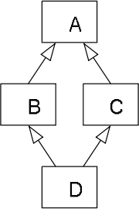
Multiple Inheritance
Classes B and C inherit directly from a superclass A.
This is single inheritance, and causes no issue on its own.
Then, class D, inherits from both B and C.
This is multiple inheritance. Class D has two superclasses: B and C.
This produces an inheritance diagram from the article.
As you can see, the shape is like a diamond, hence the name.

Slide 29
Multiple Inheritance
Why is this an issue?
Say we have a method in A, called m().
Say we override this method m() in B.
Say we do not override this method in D.
The question becomes: Which version of m() will D use?

Slide 30
Multiple Inheritance
As stated, Java does not allow pure multiple inheritance.
It does allow us to mimic multiple inheritance, however.
We do so by using interfaces.
These are similar to abstract classes and we’ll go over these in two weeks.

Slide 31
Exercise #8b

Slide 32
Casting
You may have seen before, that we can declare a reference variable to be of one type, yet it points to a different type of object.
We are able to do this in inheritance relationships and this goes back to the idea of polymorphism.
An instance of the subtype can be used when we call for an instance of the supertype.
Similarly, in the last example, we saw we could pass subtype objects to methods which call for a supertype object.
m(new GraduateStudent());
m(new Student());
m(new Person());
m(new Object());

Slide 33
Casting
What is actually going on here?
How can we pass an instance of a subtype object when we expect an instance of the supertype?
As it turns out, this does not happen magically. Once again, the Java compiler is changing our code at compile time to make sure such a thing is possible.
Specifically, Java is implicitly performing a cast operation.
Hopefully you’ve seen casting in ICS 140. If not, you can get a quick refresher in section 2.15.
Casting is simply the process of turning one type into another.
In section 2.15, you can see examples for the primitive data types: ints/doubles/chars.
We will be concerned with casting one type of object to another.

Slide 34
Casting Objects
So, consider once more the following example,
m(new Student());
As I mentioned, Java is implicitly casting in this situation. What does this look like?
Object o = new Student();
m(o);
Just as an aside,
You probably realize that we have seen many examples of Java’s ‘fiddling’ with our programs over the last few weeks.
Implicitly extending the Object class.
Implicitly inserting the super() keyword into subclass constructors.
Implicitly performing a cast such as this.

Slide 35
Casting Objects
Now, consider the reverse of the last example. Say we want to cast an Object object to be of type Student. Can we do this?
Object o = new Student();
Student b = o;
Is this possible? Will this work without any error?

Slide 36
Casting Objects
The answer is no!
Object o = new Student();
Student b = o;
Why?
Although our compiler has been clever in performing implicit additions to our programs, it is not quite clever enough to realize that our Object o is actually pointing to a Student object.
This does not automatically work because of our polymorphism argument.
A Student object is always an Object object. However, the reverse, is not necessarily true.

Slide 37
Casting Objects
Can we fix this? How do we fix this so it works as we’d expect.
We must perform an explicit cast ourselves.
An explicit cast is a cast which we type out ourselves and it is always present in our source code file.
Object o = new Student();
Student b = (Student) o;

Slide 38
Casting Objects
We can always cast an instance of a subclass to be an instance of the superclass.
This is known as up-casting.
Always possible to do this.
Can be done implicitly or explicitly.
We can also cast an instance of the superclass to be an instance of one of its subclasses, as we just saw.
This is known as down-casting.
This is not always possible.
Must be done explicitly as we must let the compiler know of our intentions explicitly.
Note that this can still fail if the object being cast is not the same type that we are trying to set.
The object to be cast must be an instance of the subclass for this to be successful.
If not, and we perform an explicit cast, we will throw an exception and the cast will be unsuccessful.

Slide 39
Casting Objects - instanceof
This brings up an interesting idea. Can we make sure that the object to be cast is of the correct type before performing the cast?
Yes! We can use the java keyword, instanceof.
Like other keywords, instanceof is completely lower case.
Syntax
refVariable instanceof Class
returns true if the variable is referencing an object of type Class.
returns false if refVariable is referencing an object of some other type.

Slide 40
The instanceof Operator
Use the instanceof operator to test whether an object is an instance of a class:
Object myObject = new Circle();
// Some lines of code.
/** Perform casting if myObject is an instance of Circle */
if (myObject instanceof Circle) {
System.out.println("The circle diameter is " +
((Circle)myObject).getDiameter());
...
}

Slide 41
Casting
You may ask yourself, what is the point of making myObject of type Object in the first place. We could skip all of the instanceof content if we simply made this of type Circle from the start.
Object myObject = new Circle();
Circle myObject = new Circle();
The idea here is that we want to program as generically as possible. This means that we should define our variable types to be instances of the supertype (Object in this case). This way, we can have that reference variable point at any subtype of that supertype, giving us more options.

Slide 42
Changing Gears The singleton design pattern
Let us ask ourselves a question. How would we go about not allowing a class to be instantiated from outside the class definition. That is, how would we not allow objects to be created from outside the class definition.

Slide 43
Changing Gears The singleton design pattern
“Why would we want to do this?”, You might have asked yourself. What good is a constructor if we cannot use it to create objects of the class from outside the class definition.
Consider the following idea. What if we only ever want a single instance of a class to exist at any given time (Within the scope of an executing program)? Could we use the idea of a private constructor to accomplish this?

Slide 44
Changing Gears The singleton design pattern
To do something along these lines, we’ll have to make a couple of considerations. First, let’s discuss the strategy.
We want to create a private constructor in our class. As you know, this means that we cannot access this constructor from outside of that particular class definition.
We then want to create an instance of the class as a private/static data field within the same class. The idea here is that we want to hold the single instance of our class within the class itself. Note that this is a form of composition. This field will initially be set to null.
Finally, we define the getInstance() method. This method will only use the private constructor when our instance of the class is null. If it is not null (meaning it has already been set using the private constructor), then do nothing and simply return the instance as it is.

Slide 45
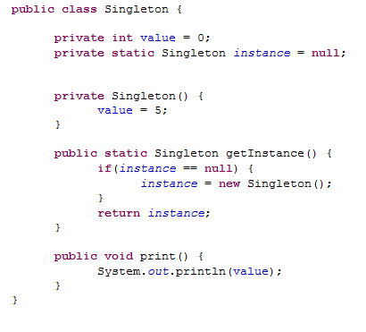
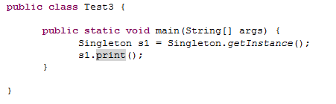
Changing Gears The singleton design pattern

Slide 46
Assignment #6

Slide 47
Lab #4

